Slide 1



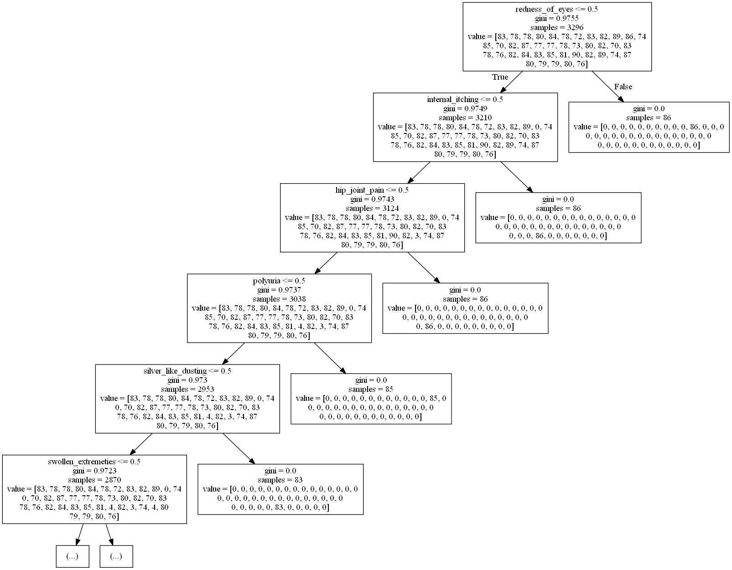

Manufacturer with Most Vehicles: Tesla with 13 vehicles
DISEASES WITH SYMPTOMS.
Problem statement
INTRODUCTION
Nowadays, most people ignore small symptoms which might lead to a very big disease going on. Our main aim is to create a model by which everyone can know the diseases and their symptoms when they fall ill.
There are many different types of diseases prevailing all around the world and people nowadays find it difficult to diagnose the disease with the symptoms they have but some are easily findable and get the right treatment.
Data analysis
FINDINGS
Best findings from a data set are those that provide valuable insights into a particular area of study and can be used to make informed decisions, improve outcomes, and drive innovation in various fields
Evaluation Metric | Value
Mean Squared Error | 0.012
Root Mean Squared Error | 0.109
R-squared | 0.897
Adjusted R-squared | 0.892
Conclusion and recommendations
Continue to develop and refine the machine learning models to improve their accuracy and reliability in predicting disease based on symptom data.
Explore ways to incorporate other types of clinical data into the models, such as patient history, lab results, and imaging data, to improve accuracy and reliability.
Validate the models on new data sets to ensure that they generalize well and are not overfit to the training data
References
‌
‌
Aniruddha-Tapas. (n.d.). Aniruddha-Tapas/predicting-diseases-from-symptoms: Training a decision tree to predict diseases from symptoms. GitHub. Retrieved February 27, 2023, from https://github.com/Aniruddha-Tapas/Predicting-Diseases-From-Symptoms
Created by:-
1- BATTE MANI SAMPATH KUMAR 2- SAI MOULIK KOLLIPARA 3- SANDEEP KILARU

